Slide 1


Twitter Sentiment Analysis
Presented By:
Sagar Vadsola
Shraddha Dharmik
Suyash Mudholkar
Vinod Sawant

Slide 2


Agenda
Problem Statement
Proposed Solution
Solution Details
Model Building
Challenges
Data Analysis & Visualization

Slide 3
Problem Statement
Twitter is a social networking service for posting personal opinions known as "tweets“
Stats:
500 million tweets are sent each day
326 million people use Twitter every month
Twitter is the number one platform for government leaders
9% more people are using Twitter daily
Idea of our project:
Scrape the data from Twitter
Form a model to predict the sentiments of people or a subject
Dataset: 500+ tweets

Slide 4
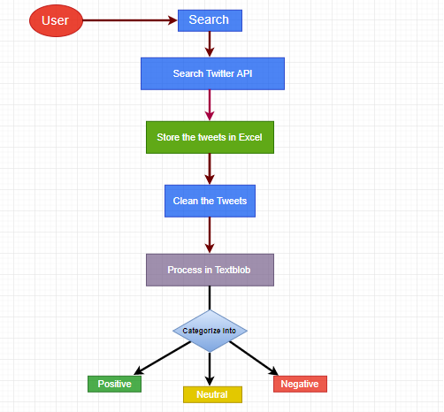
Proposed System

Slide 5
Solution Details
Extracting tweets of a subject using live Twitter Developer API - Tweepy
Storing the tweets in .xlsx format
For analysis extract the data from excel into dataframe and visualize the data to get some insights
Sentiment analysis is an important research area that identifies the people’s sentiments, opinions and emotions underlying a text
Sentiment analysis are based on tweets and from where we get polarity which includes this labels (Positive, Negative or Neutral)

Slide 6
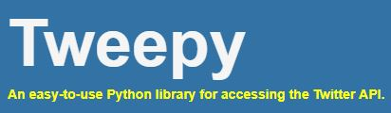
Twitter allows us to mine the data of any user using Twitter API or Tweepy
Data will be tweets extracted from the user
The first thing to do is get the consumer key, consumer secret, access key and access secret from twitter developer available easily for each user
These keys will help the API for authentication

Slide 7
Model Building
TextBlob processes all the tweets and breaks down the tweets into words
Words which mostly defines adjective gives polarity value
Maximum polarity value tends to positive view
Less value indicates negative view

Slide 8


Python library for processing textual data
Provides a simple API for diving into common natural language processing (NLP) tasks
NLP tasks using TextBlob:
Tokenization
Converts large paragraphs into sentences or words
Part-of-speech Tagging
WPRO (wh-pronoun) [What,Which]
VBD (verb,past tense) [pushed,picked]
Noun Phrase Extraction
Translation and Language Detection

Slide 9
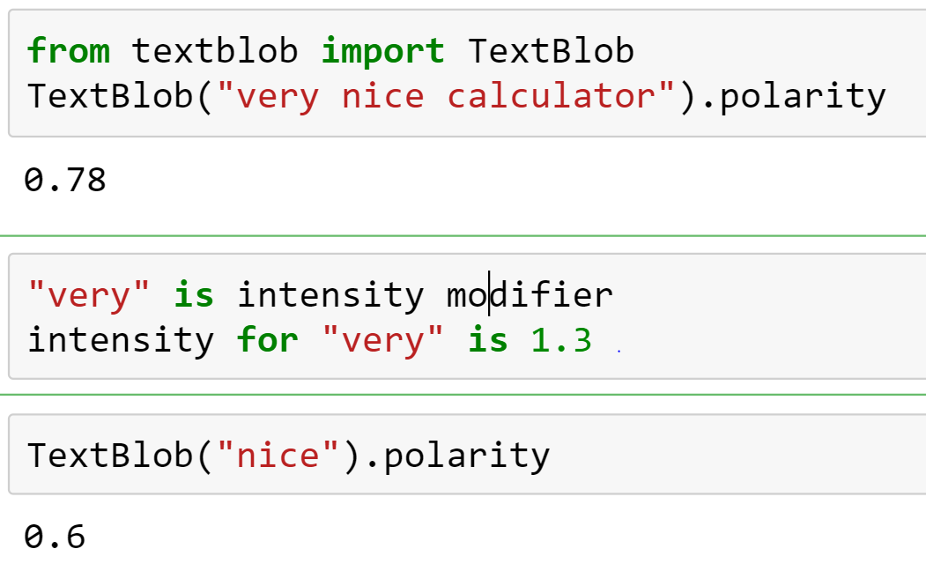

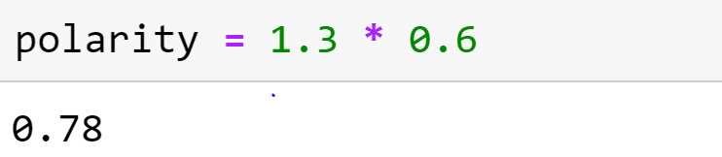
Calculating
Positive
Polarity

Slide 10
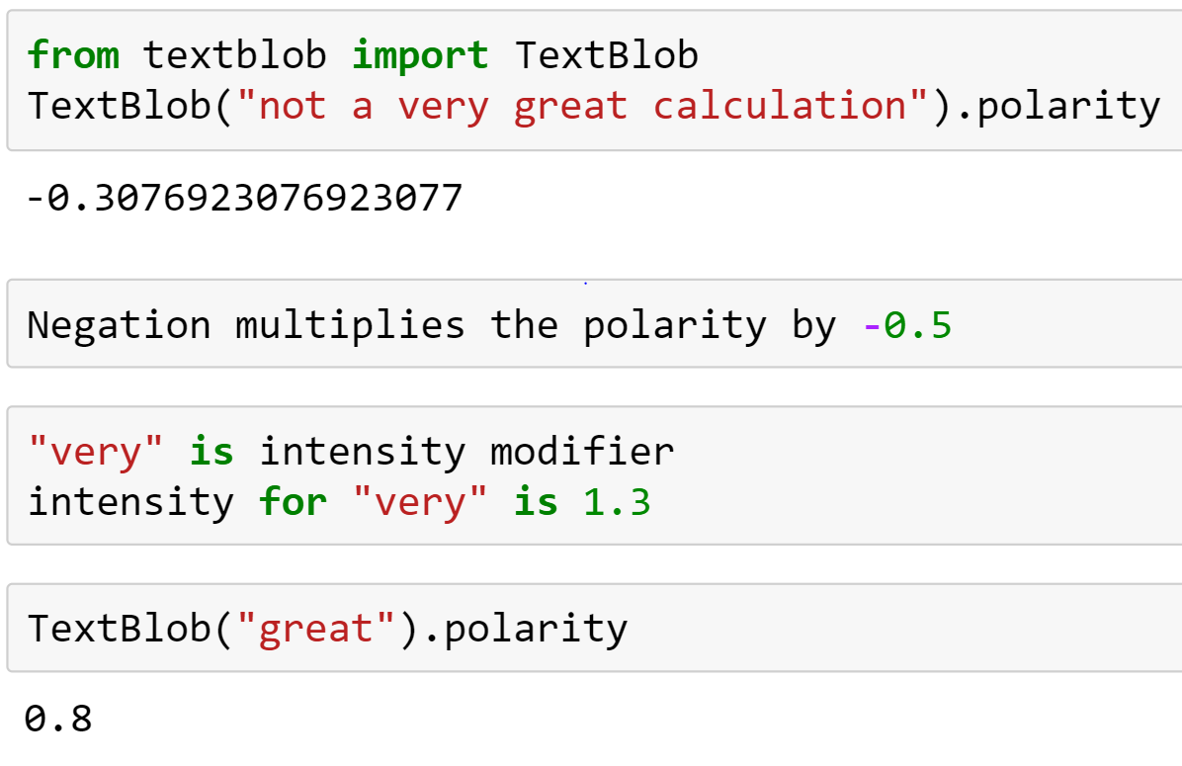
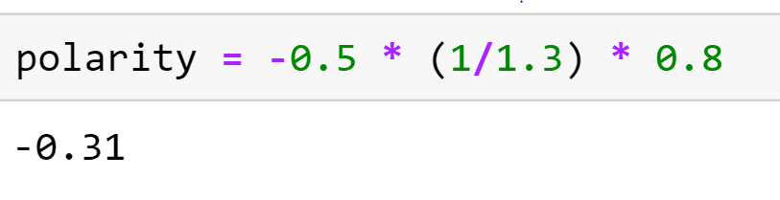
Calculating
Negative
Polarity

Slide 11

Flask is a micro web framework written in Python
Classified as a microframework because it does not require tools or libraries
No database abstraction layer, form validation, or any other components but supports extension
Extensions are updated far more regularly than the core Flask program
Applications that use the Flask - Pinterest, LinkedIn, and the community web page for Flask itself

Slide 12
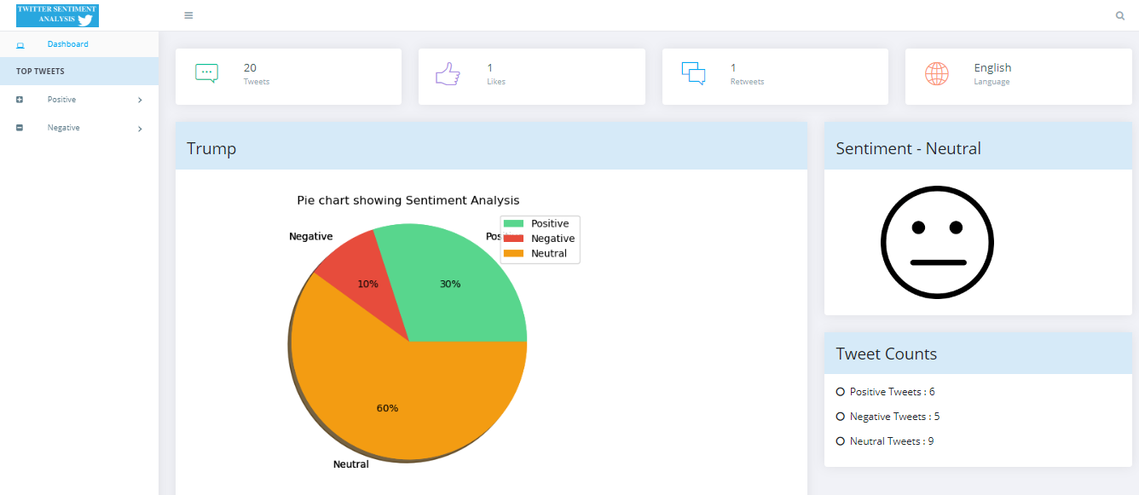
Frontend

Slide 13
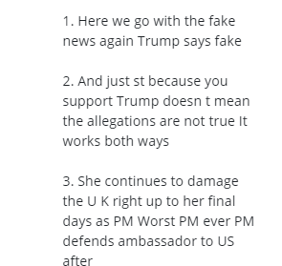
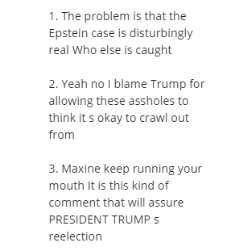
Negative
Positive

Slide 14
Challenges
The real time tweets fetched from API is a public data and doesn’t signify high-end data
Argumentation
Irony/sarcasm - It’s currently impossible to accurately assess posts that include ironic or sarcastic comments
Slangs - While some services incorporate dictionary slang, they (like most humans) cannot keep up with developments in street slang
Context - Negative and positive are not the same for everyone and brands may consider it negative to be associated with certain terms or people

Slide 15
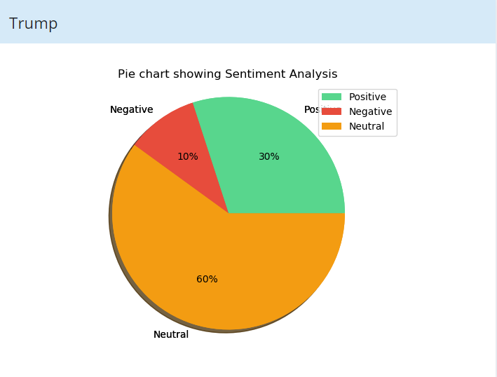
Data Analysis and Visualization

Slide 16
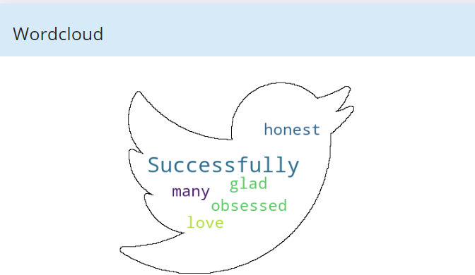

Slide 17
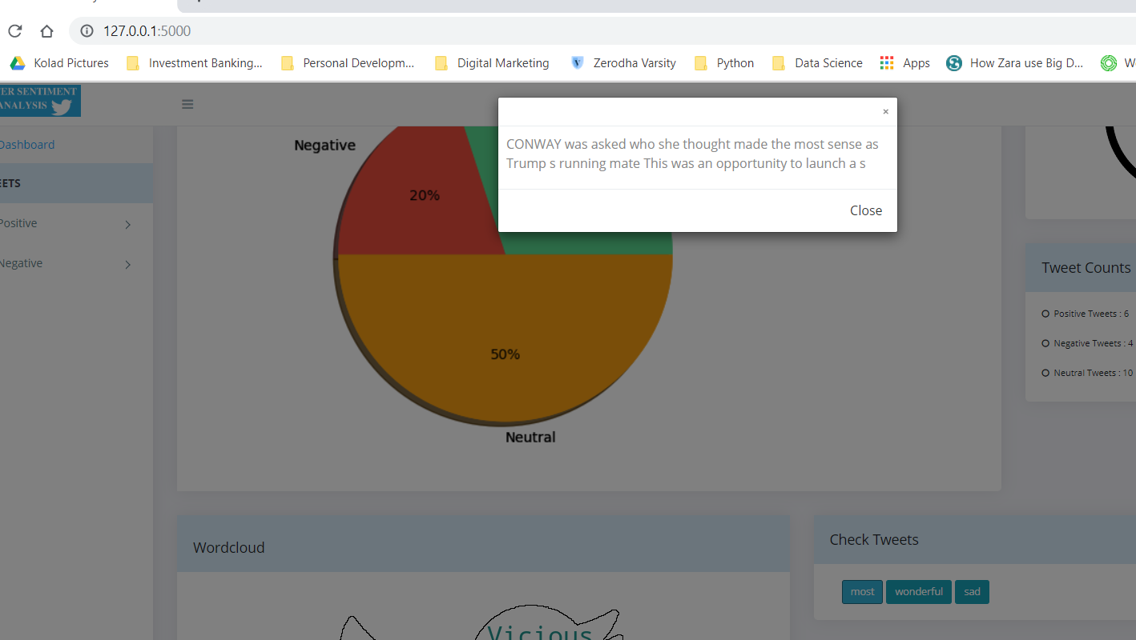
Showing tweets based on keywords

Slide 18
Road Map
Giving a video recommendation on the UI designed with a video popup tab on UI itself based on the topic of search to justify for the sentiment displayed.
To display the names of people responsible for top 3 positive and negative tweets based on the top of search.
To take into consideration tweets posted by business and premium accounts for the topic of search to add a professional touch to the sentiment being predicted.
Detailed analysis on various parameters based on tweets fetched.

Slide 19

Thank You

